Slide 1


Music Store Data Analysis: Using SQL
Dive into the world of SQL and explore a comprehensive dataset from a music store. This presentation showcases how data analysis can provide valuable insights for decision-making. Get ready to learn key SQL concepts through practical queries and discover the power of data-driven strategies.
by yahya Saukatali

Slide 2


Introduction
Project Overview
Dataset Details
This project delves into the world of data analysis using SQL, focusing on a music store dataset. Through 11 queries, the presentation explores various aspects of the data, including customer preferences, employee performance, and revenue patterns.
The dataset encompasses customer information, invoices, tracks, artists, genres, and employees, providing a comprehensive view of the music store’s operations. This analysis reveals valuable insights to guide strategic decisions and improve business outcomes.

Slide 3

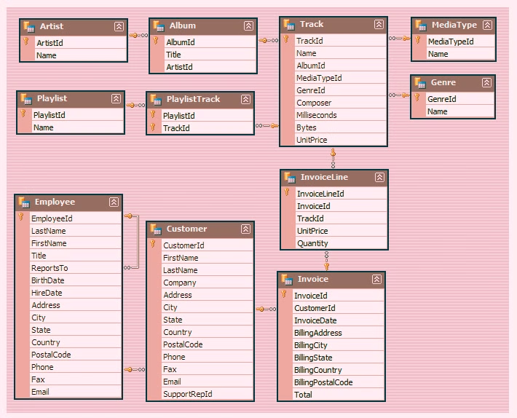
Schema

Slide 4

SQL Queries Overview
1
Q1: Senior Employee Identification
2
Q2: Top Invoice Countries
3
Q3: Top 3 Invoice Totals
Identifying the most senior employee based on their job title.
Determining the countries with the highest number of invoices.
Retrieving the top 3 total invoice values.
4
Q4: Best Customer City for Music Festival
5
Q5: Best Customer Overall
6
Q6: Rock Music Listeners
Identifying the city with the highest sum of invoice totals to host a promotional music festival.
Determining the customer who has spent the most money overall.
Retrieving email, first name, last name, and genre of all rock music listeners.
7
Q7: Top Rock Bands
8
Q8: Songs Longer Than Average
9
Q9: Customer Spending by Artist
Identifying the top 10 rock bands with the most tracks in the dataset.
Retrieving track names and durations for songs longer than the average length.
Calculating the amount spent by each customer on specific artists.
10
Q10: Most Popular Genre per Country
11
Q11: Top Customer per Country
Identifying the most popular music genre based on total amount spent in each country.
Determining the customer who has spent the most on music in each country.

Slide 5

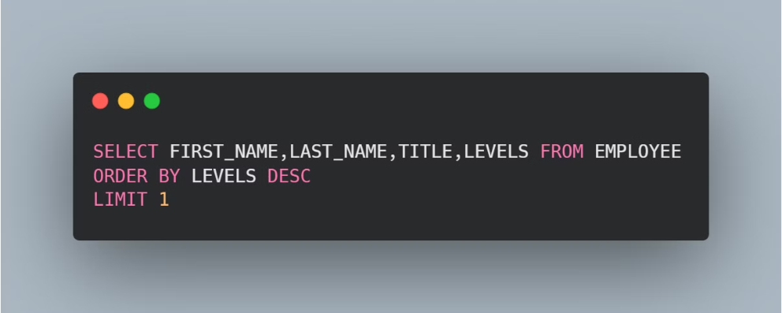
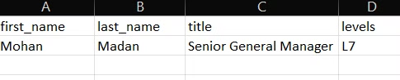
Q1: Who is the senior most employee based on the job title?

Slide 6

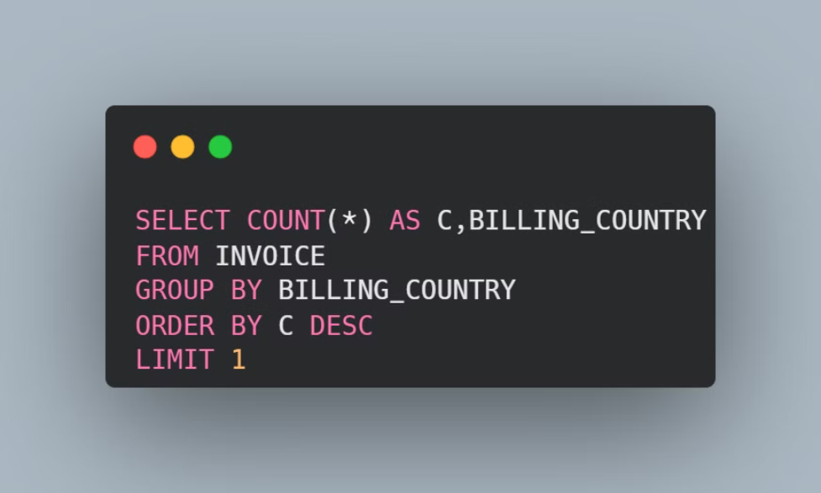
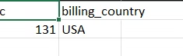
Q2: Which countries have the most invoices?

Slide 7
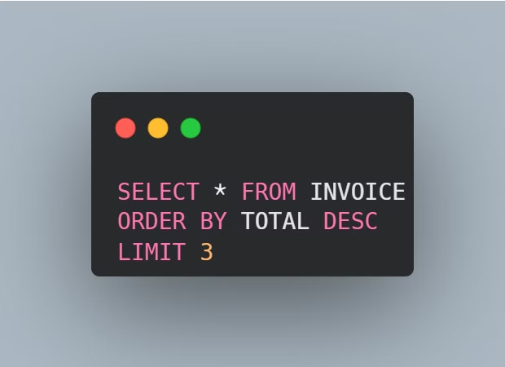
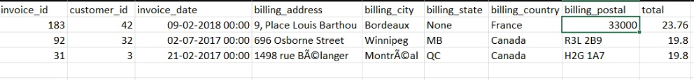
Q3: What are the top 3 values of total invoice?

Slide 8

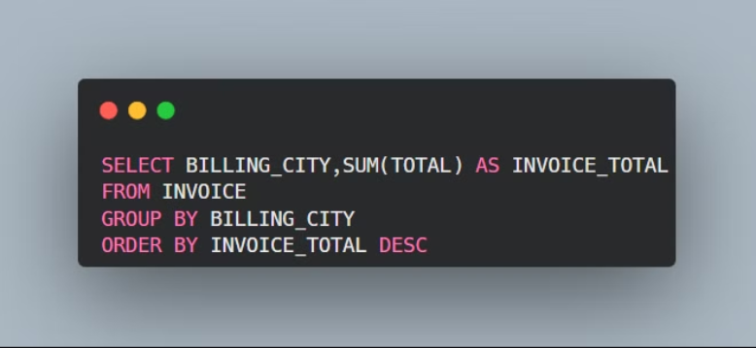
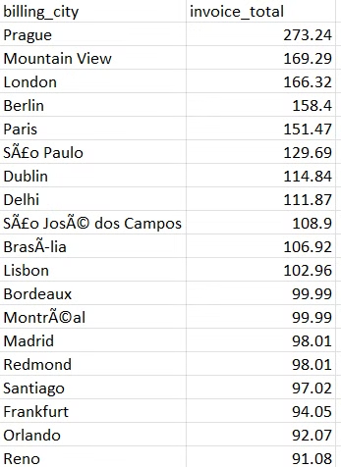
Q4: Best Customer City for Music Festival

Slide 9
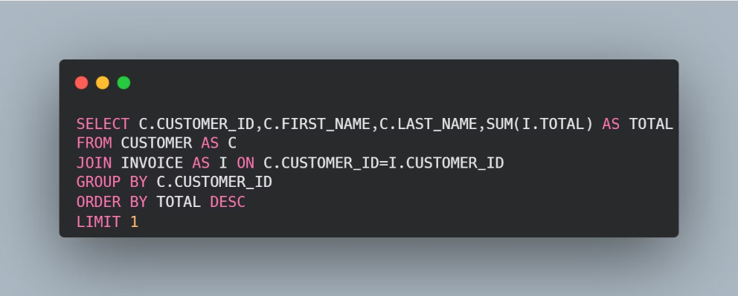
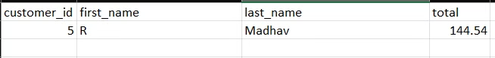
Q5: Who is the best customer?

Slide 10

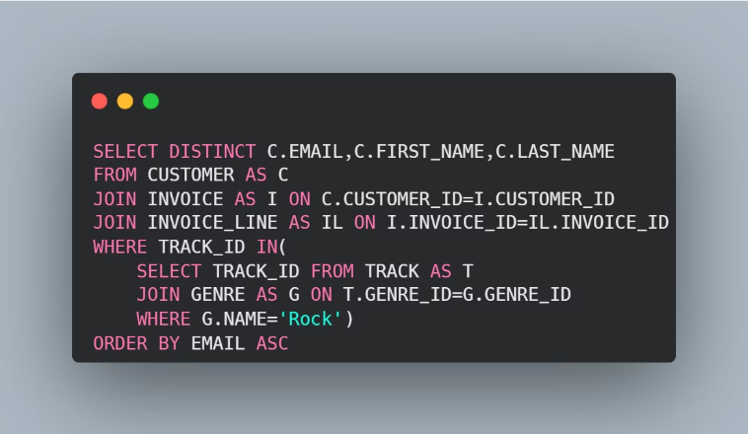
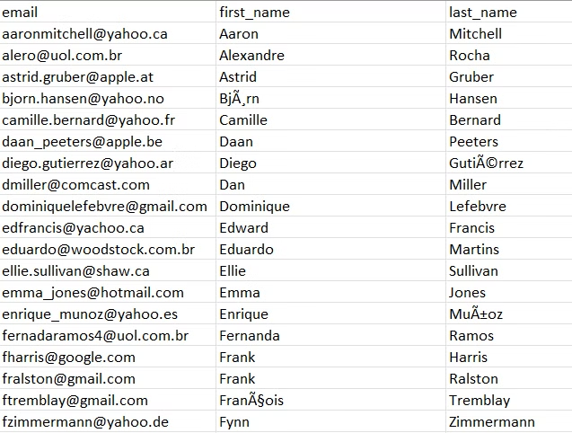
Q6: Rock Music Listeners

Slide 11

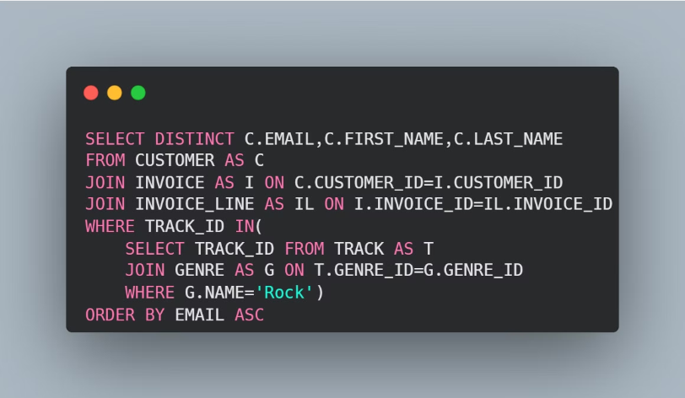
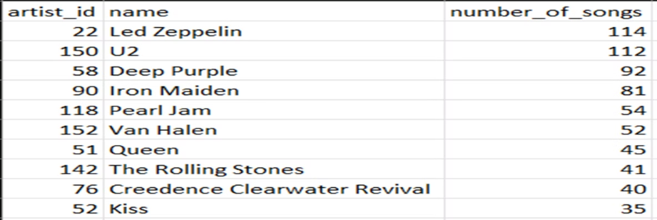
Q7: Top Rock Bands

Slide 12

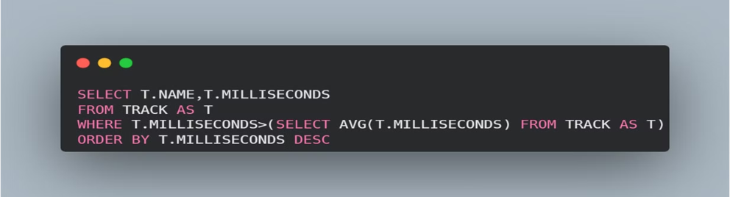
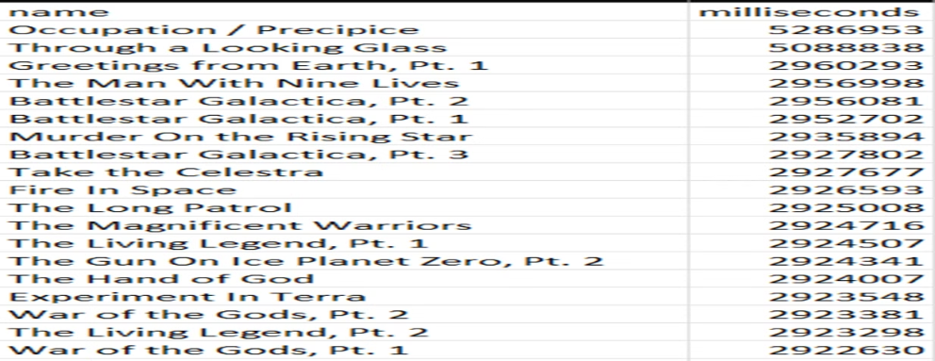
Q8: Songs Longer Than Average

Slide 13
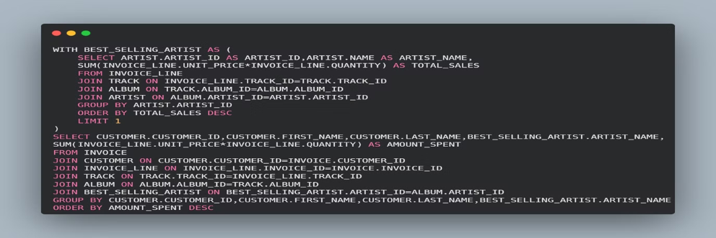
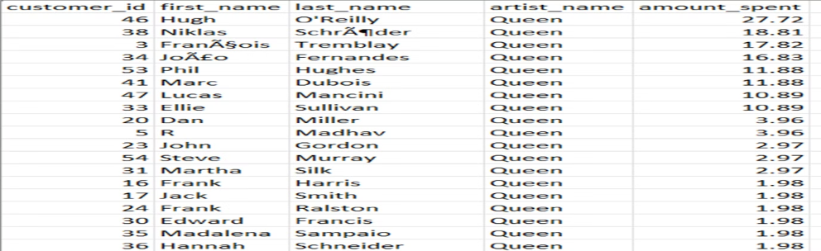
Q9: Customer Spending by Artist

Slide 14

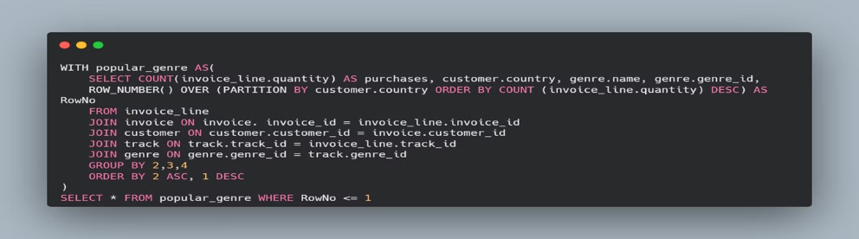
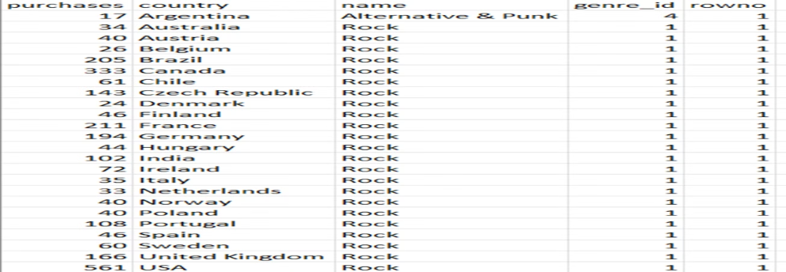
Q10: Most Popular Genre per Country

Slide 15

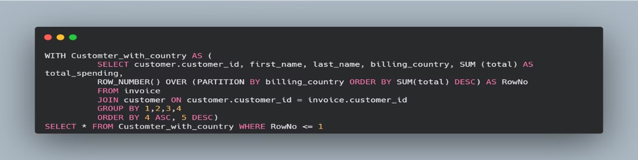
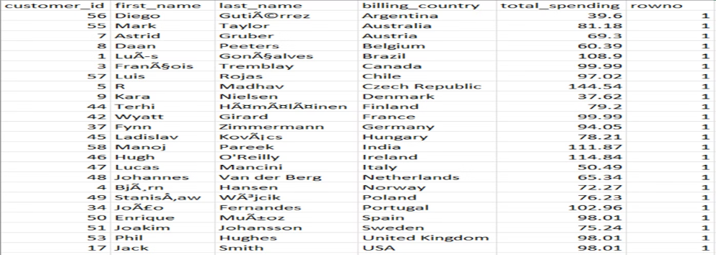
Q11: Top customer per Country

Slide 16



